Slide 1
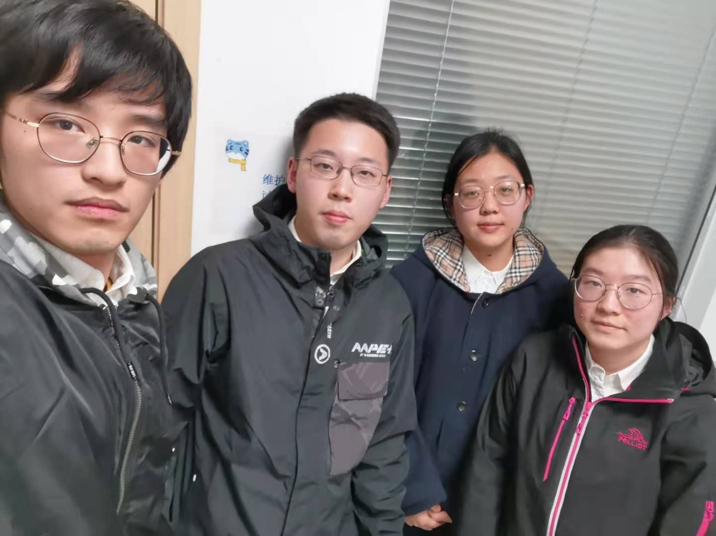
VC211 E3 presentation Fall 2020
Spectrophotometric Analysis: Phosphates in Water
Section3 Group 3
Yibei Han 519370910123 hyb_2001@sjtu.edu.cn
Xinyi Lu 519370910123 luxinyi0305@sjtu.edu.cn
Kaixin Shen 519370910128 812852899@sjtu.edu.cn
Zongkai Zhang 519370910109 sceeek@sjtu.edu.cn
Instructor: Ting Sun ting.sun@sjtu.edu.cn

Slide 2
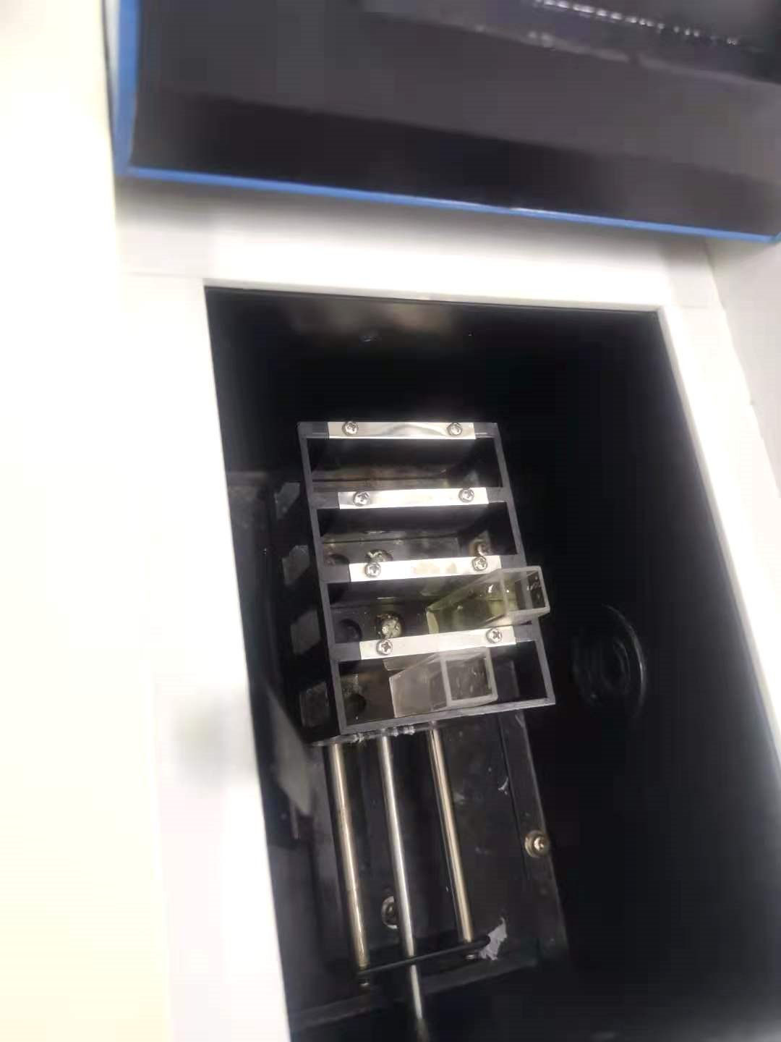
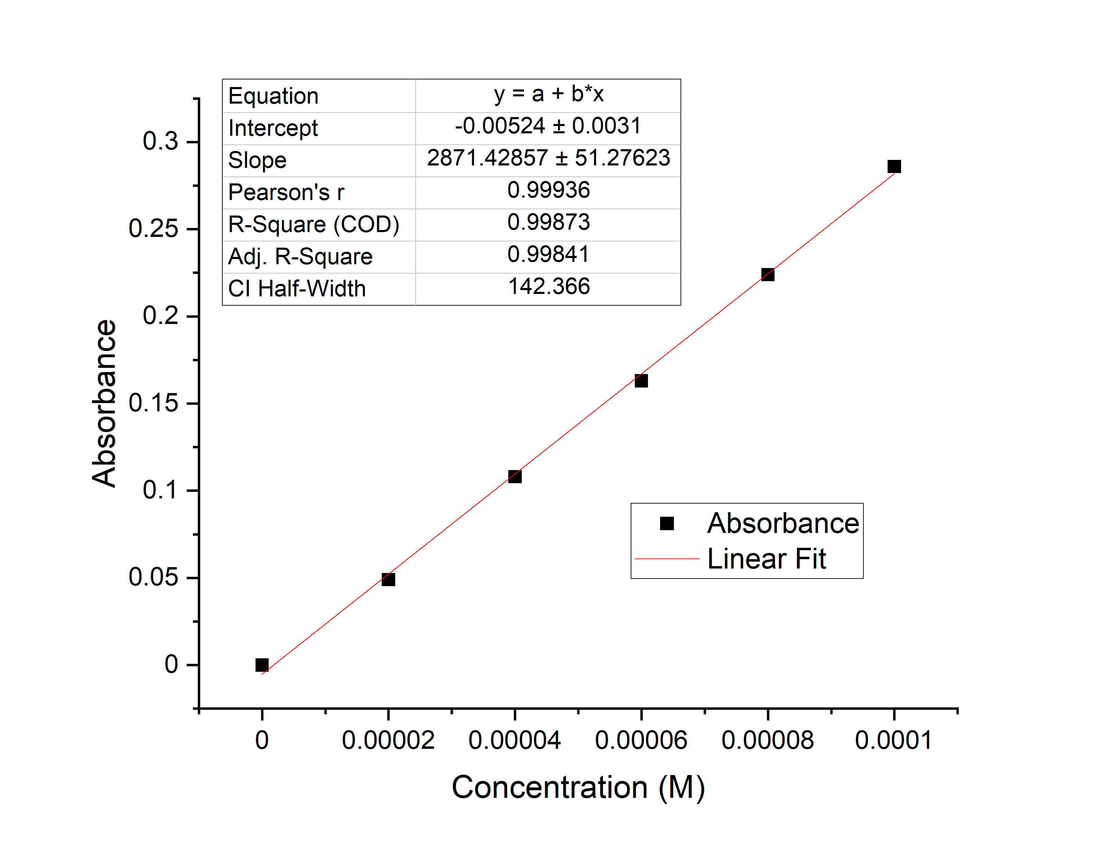
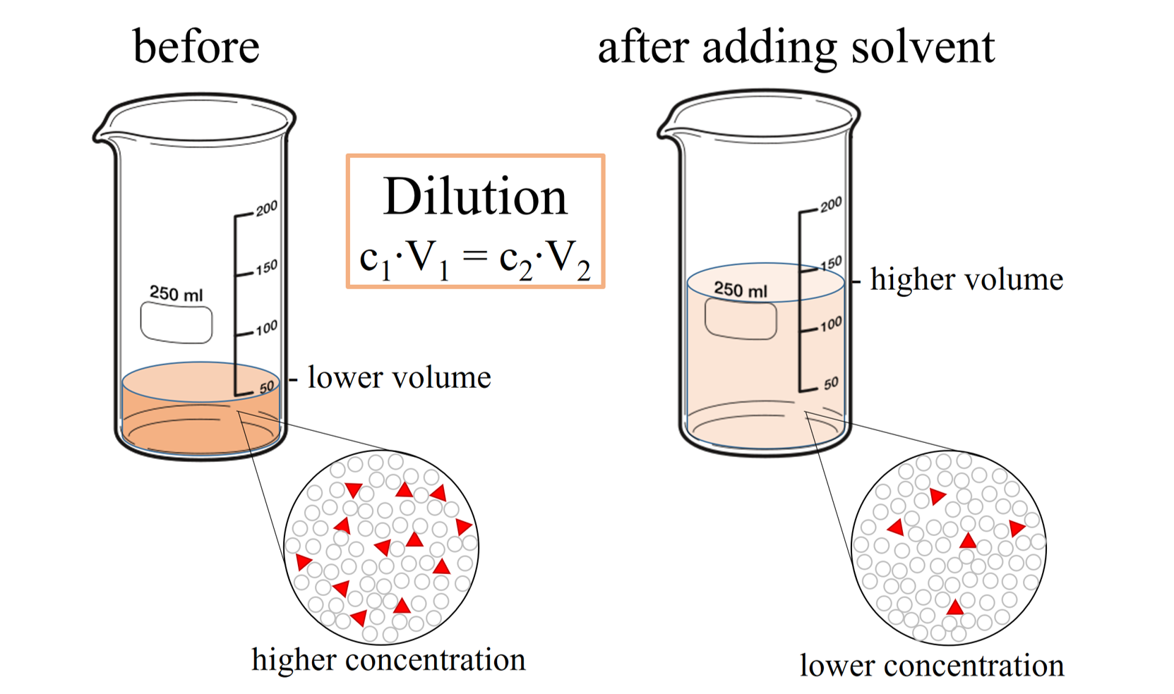
Objectives
A. Dilutions of solutions
B. Spectrophotometry analysis experimental solutions
C. Construction and utilization of calibration curve

Slide 3
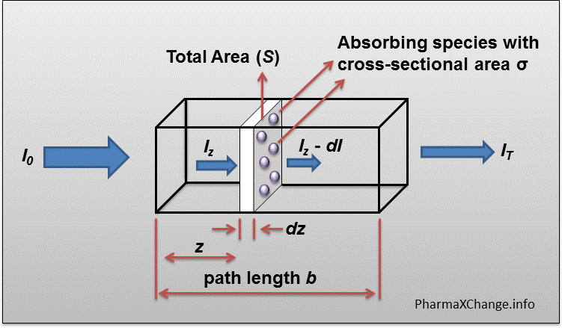
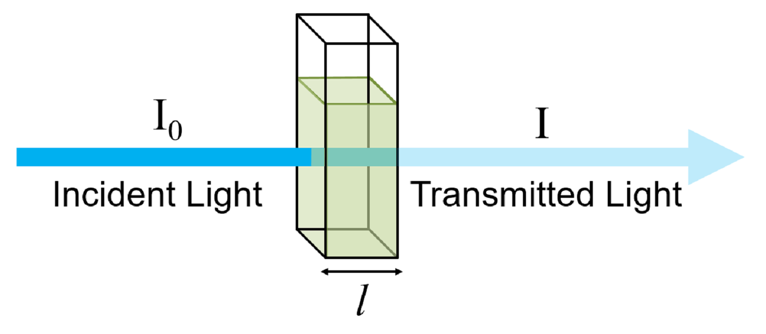

Theory
Molar absorptivity
Concentration
Lambert-Beer Law: A (absorbance) = -lg(T) = ε * l * c
Solution path length
Transmittance: T =$\frac{I}{I_{0}}$

Slide 4
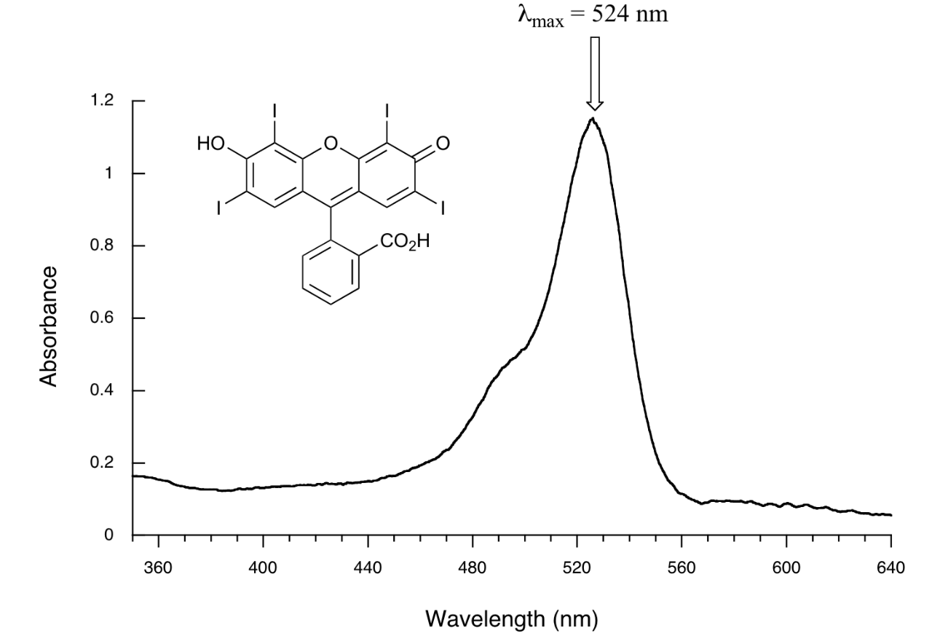
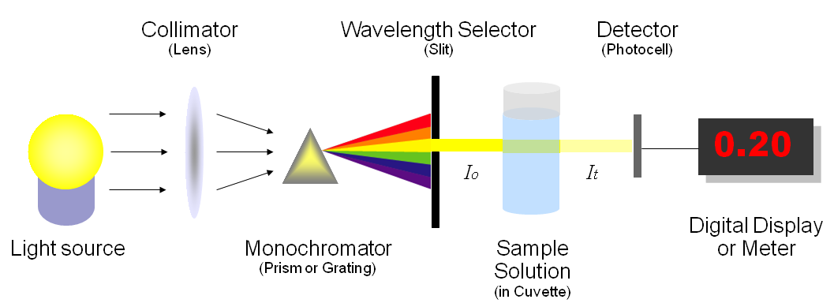
Background
Absorption spectrum: Spectrum of absorbance vs wavelength
λ_{opt} : Optimum wavelength at which the light is best absorbed
Spectrophotometric Analysis: Absorbed light vs concentration
Dye: NH₄VO₃+MoO₄₂₋+PO₄₂₋³⁻ → (NH₄)₃PO₄·NH₄VO₃·16MoO₃
Calibration curve: Fitting of known data
yellow

Slide 5
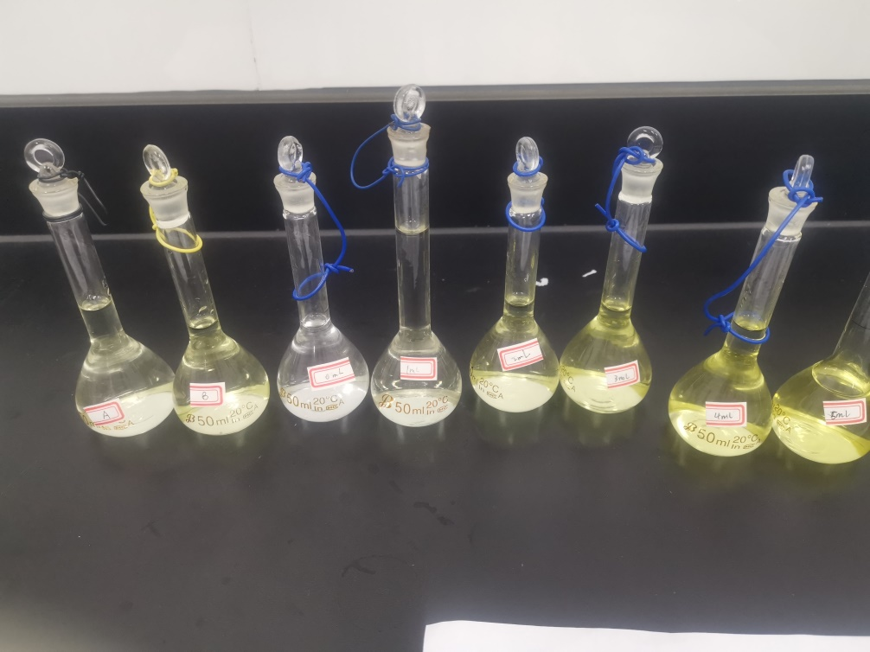
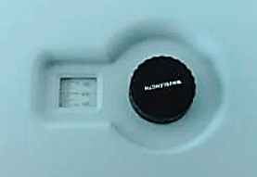
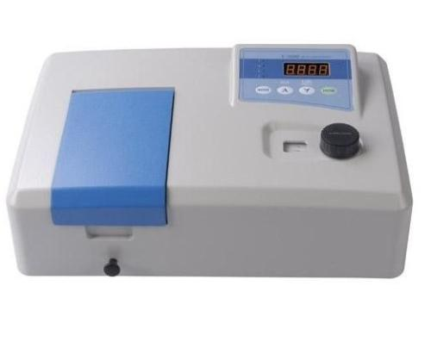
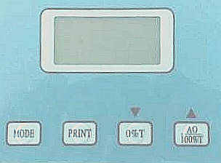
Brief Procedure
Prepare standard solutions
50mL 0M, 1M, 2M, 3M, 4M, 5M and 50mL A, B
Adjust the spectrophotometer
Set the mode to “%T” , open the cover and set 0%
Put a cuvette with solution #1 to be 100%
Make the absorbance spectrum & find λ using solution #6
Set the mode to “A” and record correspondent λ
Make the calibration curve
Measure the absorbance of standard solutions
Determine the unknown concentration

Slide 6
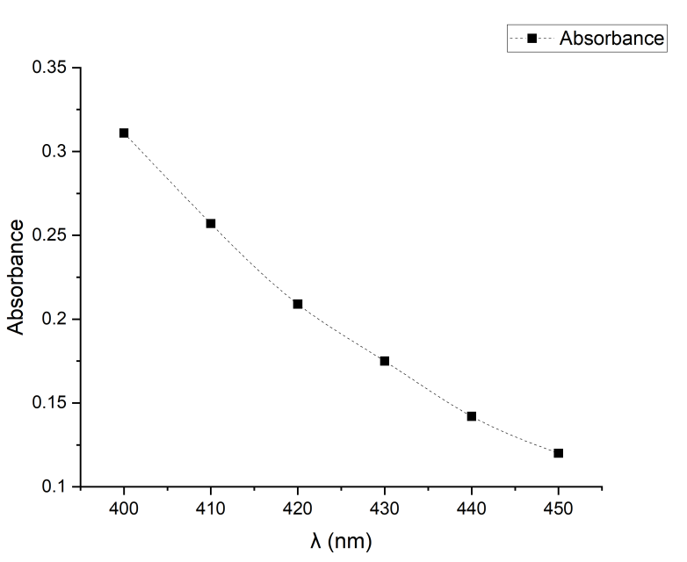
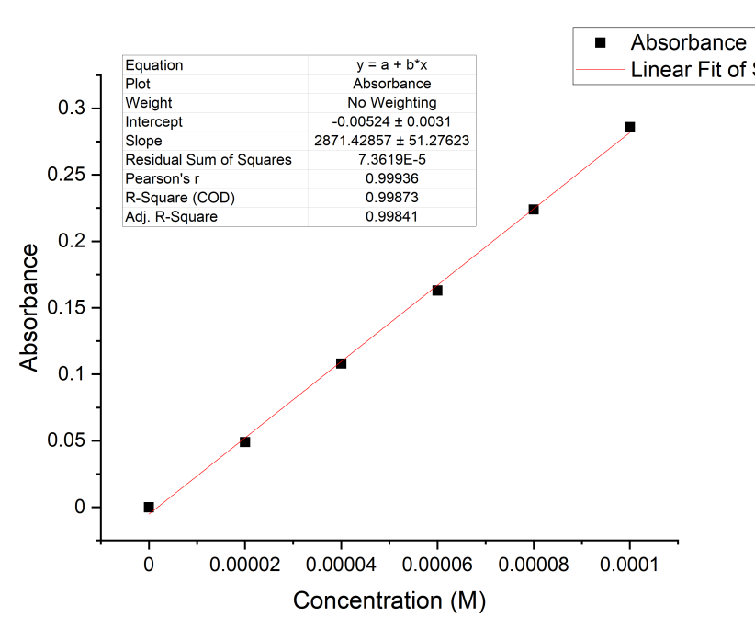


Data Analysis
Table 2: Absorbance under light with
different frequency
λ(nm) | 400 | 410 | 420 | 430 | 450
A | 0.311 | 0.257 | 0.209 | 0.175 | 0.120
$$λ_{OPT}=400nm$$
Table 3: Absorbance of six sample solution
Sample | 1# | 2# | 3# | 4# | 5# | 6#
V (mL) | 0.0 | 1.0 | 2.0 | 3.0 | 4.0 | 5.0
C (M) | 0 | 2E-5 | 4E-5 | 6E-5 | 8E-5 | 1E-4
A | 0.000 | 0.049 | 0.108 | 0.163 | 0.224 | 0.286
$$A=2871.4C−0.0052$$
calibration curve

Slide 7
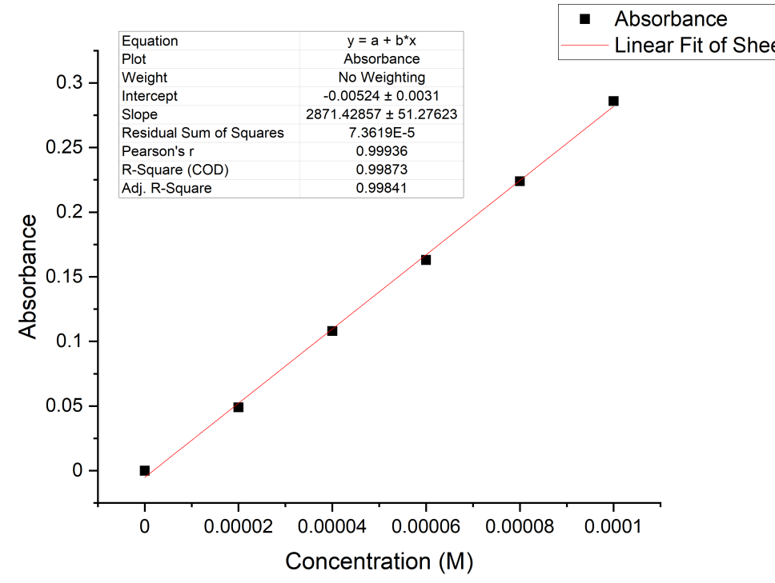

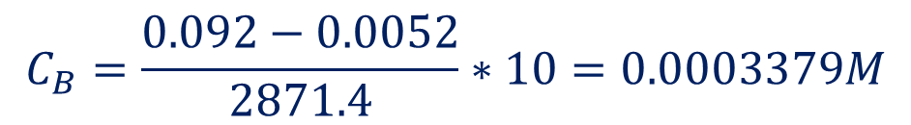
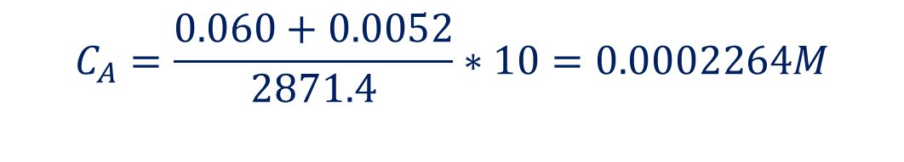
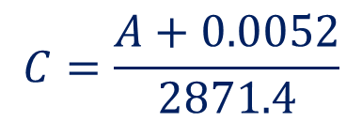
Data Analysis
Table 3: Absorbance of six sample solution
Sample | 7# A | 7# B
Absorbance. (A) | 0.060 | 0.092
$$A=2871.4C−0.0052$$
$$C=\frac{A+0.0052}{2871.4}$$
$$C_{A}=\frac{0.060+0.0052}{2871.4}∗10=0.0002264M$$
$$C_{B}=\frac{0.092−0.0052}{2871.4}∗10=0.0003379M$$

Slide 8
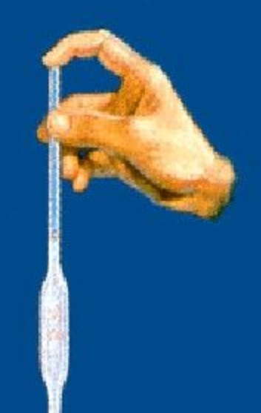
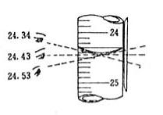

Error Analysis
Preparation of Standard Solutions
Liquid may drop outside the volumetric flask → lower concentration and absorbance
Solution remain in the pipet → lower concentration and absorbance
Read the scale from the upward view → smaller volume → greater concentration and absorbance
Colder than the working temperature (20°C) → smaller volume → higher concentration and absorbance.

Slide 9
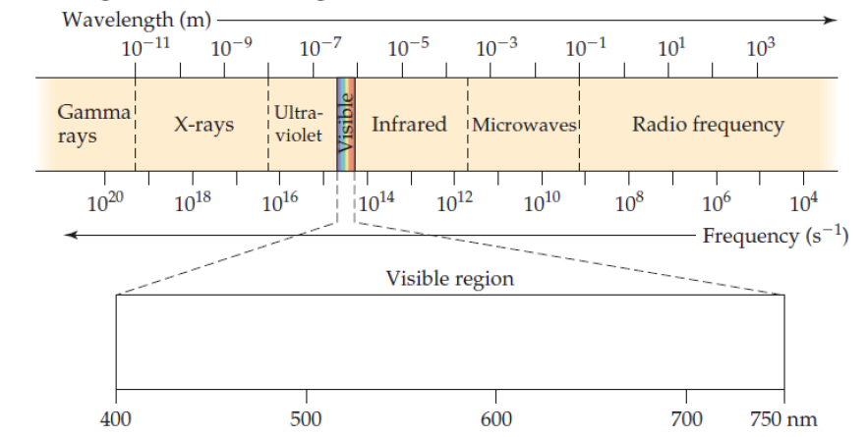
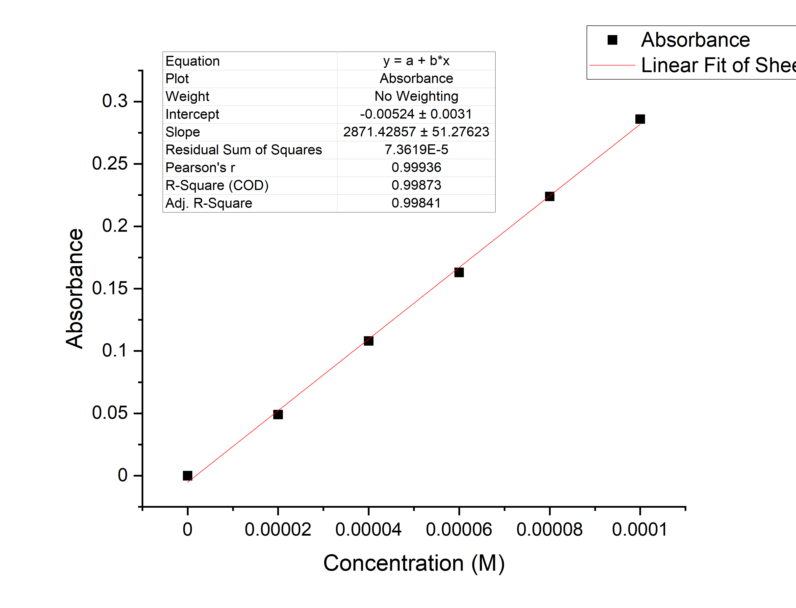

Error Analysis
B. Making the Absorbance Spectrum & Finding using a Standard Solution
Different knob position
Limit λ range
C. Making the Calibration Curve Using the standard Solutions
A positive intercept on x-axis → lower concentration

Slide 10
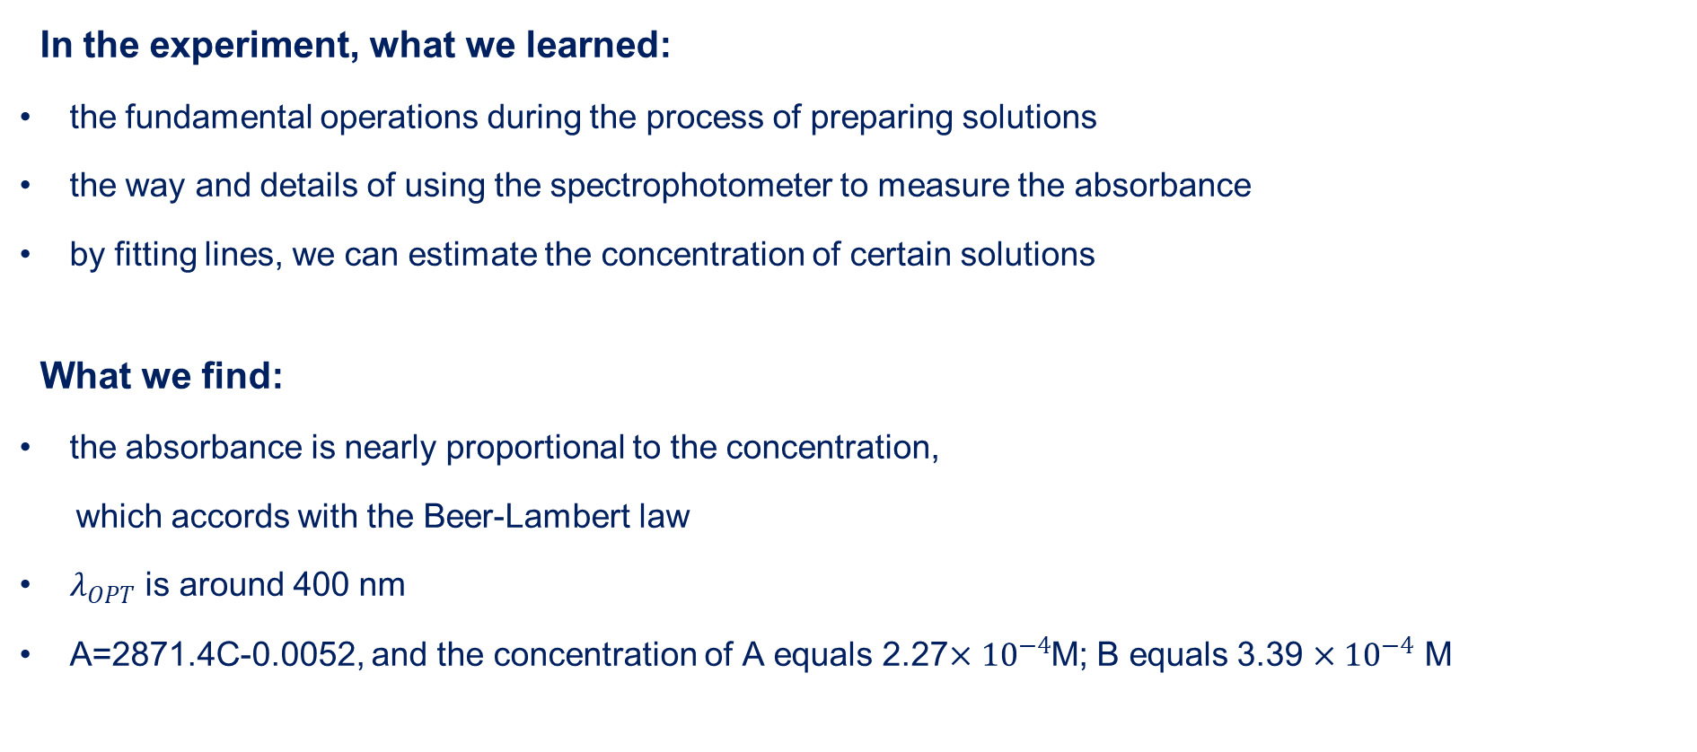
Conclusion
In the experiment, what we learned:
the fundamental operations during the process of preparing solutions
the way and details of using the spectrophotometer to measure the absorbance
by fitting lines, we can estimate the concentration of certain solutions
What we find:
the absorbance is nearly proportional to the concentration,
which accords with the Beer-Lambert law
$λ_{OPT}$ is around 400 nm
A=2871.4C-0.0052, and the concentration of A equals 2.27$×{10}^{−4}$M; B equals 3.39 $×{10}^{−4}$ M

Slide 11

Recommendation
Read the manual and listen to the lecture carefully to ensure that you know how to operate the spectrophotometer. This will save much time and improve the efficiency
Abandon data with a large deviation. These data may be inaccurate and will cause larger error to the process of fitting the line
Warm up before using the spectrophotometer, otherwise the measurement value will be erratic
Don’t pinch the smooth surface of the cuvette, instead, pinch the ground glass one
The solution should be fully mixed without bubbles

Slide 12
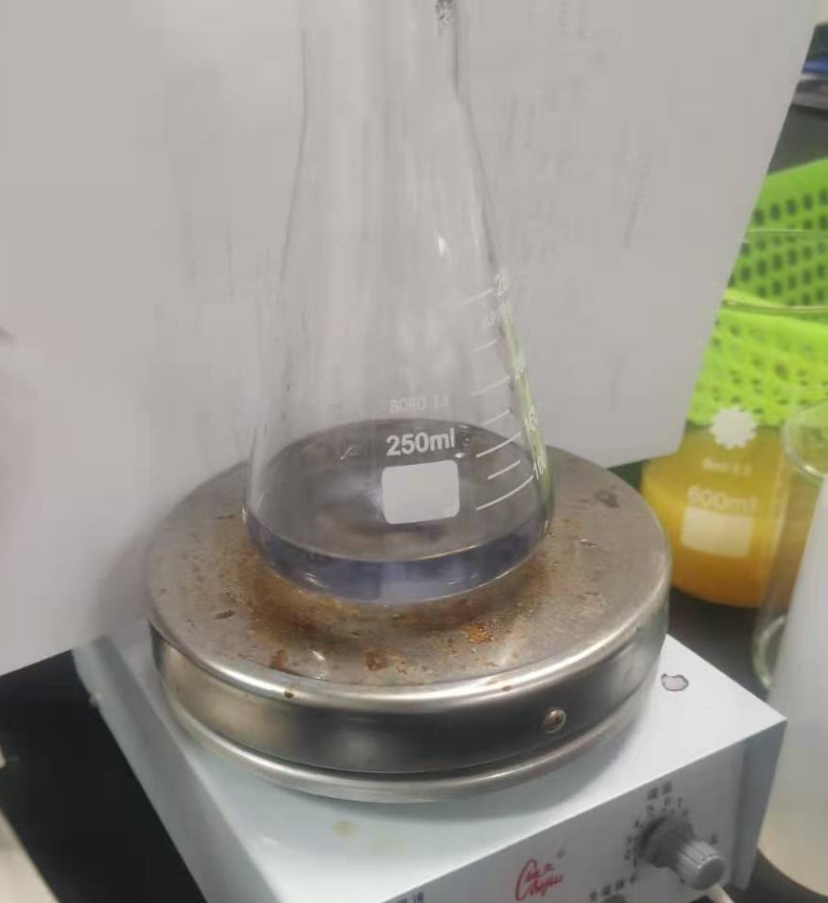
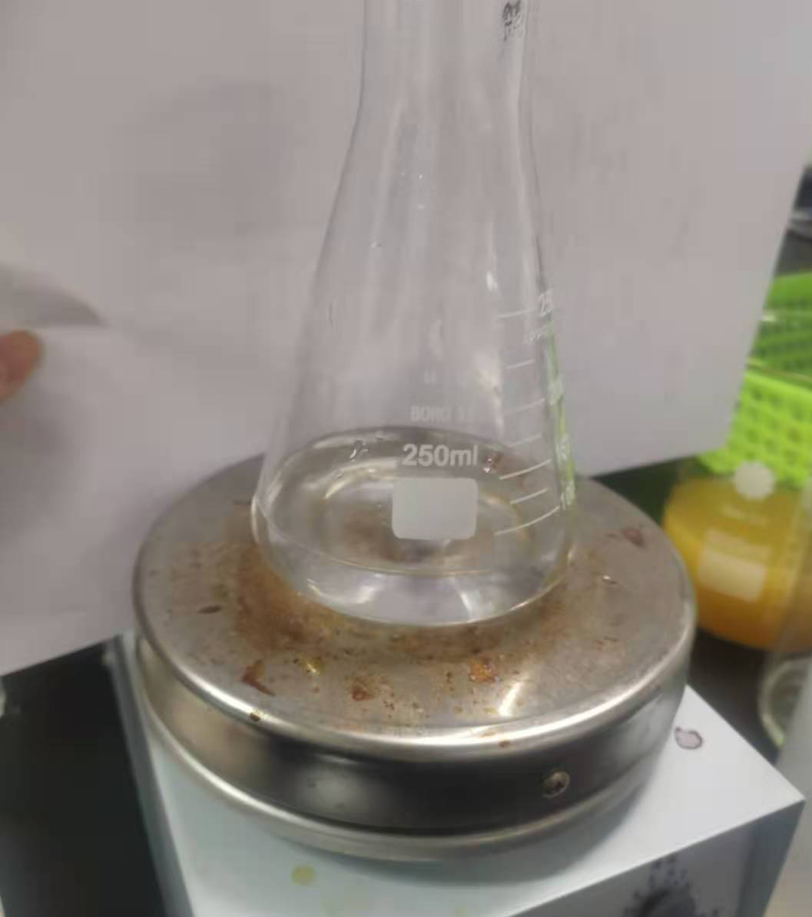
Application
In E4, we studied the factors influencing the reaction rate. We can also use spectrophotometer to help do this. After mixing, immediately record the reading on the spectrophotometer. Then record readings at a regular interval. The change of absorbance indicates the change in concentration of certain material, which can be used to calculate the rate.

Slide 13
Reference
[1] VC211 Laboratory Manual, UM-SJTU JI &SJTU Chemistry Department, 2019-2020.
[2] Peter Atkins, Chemical Principles The Quest for Insight Seventh Edition, Macmillan education, 2016.

Slide 14


